Slide 1
Draper Community Engagement
October 26 (in-person)

Slide 2
Discussion Topics
Boards & Committees
Community Christmas Function
Construction Updates
Slope Stability Monitoring Program Update
Draper Entrance Sign
Trail Feasibility Study
Municipal Development Plan Update
Tour of Council Chamber & Indigenous Artwork
Engagement Feedback Survey

Slide 3
Boards and Committees - Recruitment
There are many boards and committees that help to advise Mayor and Council on matters that impact the public, giving residents access and input with government decision makers!

Slide 4
Boards and Committees - Recruitment
Who can apply?: Residents of the RMWB.
Each board requires different experience/skill-sets
What's the time commitment? On average two years
Typically meet monthly
When can I apply? Applications accepted until October 28
Where do I apply? online at rmwb.ca/boards

Slide 5
Annual Draper Residents Christmas Celebration
Thursday December 8th, 2022
Royal Canadian Legion in Waterways
5:30 p.m. Doors open
6:30 p.m. Christmas Dinner
RVSP to Koralee.Samaroden@rmwb.ca from the Indigenous & Rural Relations team by December 1st.

Slide 6
Reach 11 Flood Mitigation
Still an active construction site
Construction is progressing on schedule.
Expected completion Fall 2023.
Construction will be shut down for winter late by October/early November (weather dependent)
Saline Creek Parkway will remain closed south of McCormick Drive and access to Draper will continue be through the detour.
Haul roads to the clay borrow area will be blocked off as part of winter shutdown.
rmwb.ca/construction >> Draper >> Reach 11

Slide 7
Roads Construction
Draper Road (Phase 2)
Substantially complete. Working on deficiencies.
Riverbend Close
Construction started in August 2022.
First lift of asphalt complete. Next steps – Ditch work.
Expected completion - Sept 2023
Garden Lane
Construction to start in May 2023
Expected completion – Sept 2023

Slide 8
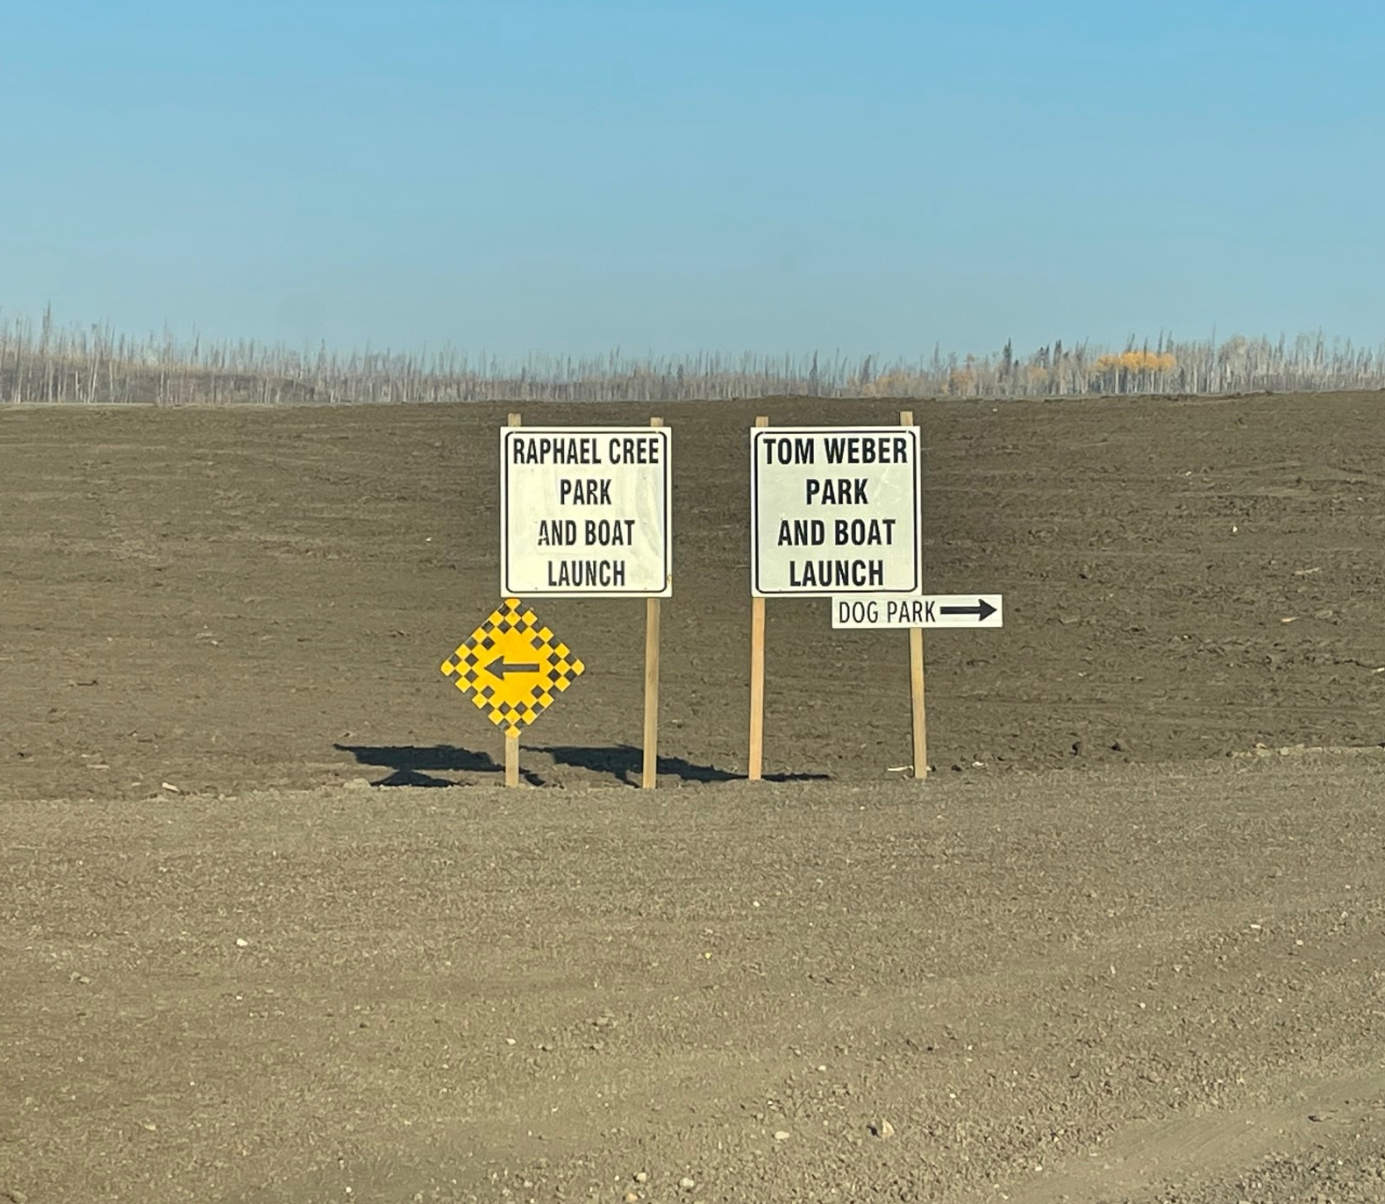
Sara Holden Dog Park
The park is now open!
Exposed topsoil fenced off. Area is seeded and will remain fenced off until the grass grows next year.
Access to the park is from Tom Weber Access only (South boat launch)
Other two public access are still closed (from Raphael Creek & Multi-Use Trail)
Outside the Park's fence line is an active construction zone for Reach 11.

Slide 9
Sara Holden Dog Park

Slide 10
Sara Holden Dog Park

Slide 11
Slope Stability Monitoring Program
Slope stability monitoring is a region-wide program
Includes Draper and other areas around the region as needed
Where We Are Now:
Summer 2022 – Assessed Draper area to identify locations to place slope stability monitors
Consultant has drafted a plan for placing instrumentation – pending approval by RMWB
Instrumentation to be installed after plan is approved
Residents to be notified before installing on private property

Slide 12
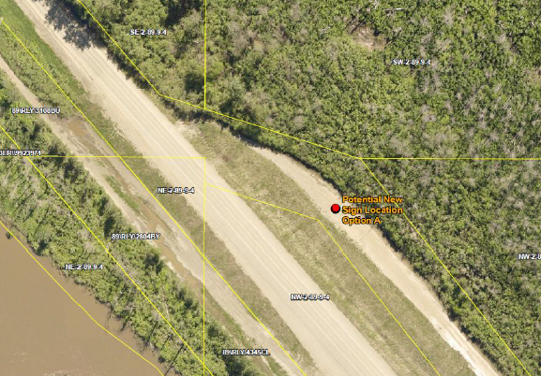
Draper Entrance Sign
Draper was invited to share feedback on a preferred location for a new community sign and historical icon.
Engagement ran from August 10 – Sept 7
Survey results:
Location: Before the entrance of Draper
Due to current Reach 11 construction
installation is anticipated for 2024.
Icon: Train
What We Heard Report available online at
rmwb.ca/participate
Notes:
Once I connect to the Rural Water and Sewer System, how much will my utility bills be?
You will receive a utility bill every two months. Your bill will always contain the following charges:
Rural Water Sewer Connection fee: Depending on how you chose to finance your connection, this rate could vary. For most homes, the Rural Water and Sewer Connection fee will be - $65.00. On your first utility bill after connecting, this fee will likely be $ 68.25, as it is prorated.
Fixed Water fee: $ 42.56
Water Consumption fee: a variable rate of $0.88/m3, and is based on how much water you consume and is measured from your water meter.
Fixed Sewer fee: $21.82
Sewer Consumption fee: a variable rate of $0.52/m3, and is calculated using the same amount of water you consumed, but at a lower rate.
Garbage collection fee: fixed rate of $53.16 (includes waste disposal fees, recycling and curbside collection)
How are these charges calculated?
These above rates are based on a residential water meter that is 16 mm or 19 mm in size. There are different rates for larger water metres and higher rates for homes in Fort McMurray. Although it’s unlikely your home has a bigger water meter than 19 mm, it is possible. If your water meter is a different size, your rate can be found in the Council approved Fees, Rates and Charges bylaw (No. 21/019).
Based on an average consumption of 20 cubic metres, your estimated bi-monthly utility bill after connecting will be $210.54. These are 2022 rates from the Council approved Fees, Rates and Charges Bylaw (No. 21/019). This bylaw is updated annually, typically in the first quarter. It’s customary to see increases to utility rates as part of the bylaw updates. The rates in the approved, current bylaw are what will be reflected on your utility bill.
Why does the sewage metered rate match the water metered rate on my bill, if a significant amount of the water I’m using is for landscaping or outdoor use?
The variable sewer charge on your bi-monthly bill is based on the amount of metered water that you use, but it is a discounted rate. There is no way to meter the amount of sewer used, and this practice is in line with other municipal utility rates.
How do my rural utility charges compare to Fort McMurray utility charges?
Water and sewer rates in the rural communities are lower than in Fort McMurray.
Water: Fixed + Variable Fee
Sewer: Fixed + Variable Fee
Urban Service Area - Residential
$37.23 + $0.88 /m3
$18.17 + 0.52/m3
Rural Service Area - Residential
$21.28 + $0.88/m
$10.91 + 0.52/m3
*The variable fees above reflect a standard meter size of 16mm & 19mm.*
Other meter sizes are reflected in the Fees, Rates and Charges Bylaw

Slide 13
Trail Feasibility Study: Coming Soon
Timelines: Expected to begin in November.
Consultant: EDS Group Inc - experienced with OHV Master Plan Update, and Abasand OHV Staging Area.
Project Scope: Assessment of existing conditions for the Draper trail that currently connects Saprae Creek with the designated OHV staging area at the Tom Weber Boat Launch (approximately 15 km)
Purpose: Understand the needs for this trail (perspectives from various users) and the vision for future use of the trail.
Engagement Plan: Includes getting feedback from area residents, OHV users, and trail enthusiasts.

Slide 14
Municipal Development Plan (MDP)
Administration is currently reviewing and considering feedback from the Phase 3 public engagement.
This includes feedback from Draper residents.
Next Steps:
Finalize the draft plan
Present to Council for their consideration
Timelines for the public hearing process for the final MDP will be shared publicly when available.
Notes:
EDS is familiar with our region and have already done work for the OHV Master Plan Update, and Abasand OHV Staging Area. They are working on Draper Trail and Outdoor Equipment.

Slide 15
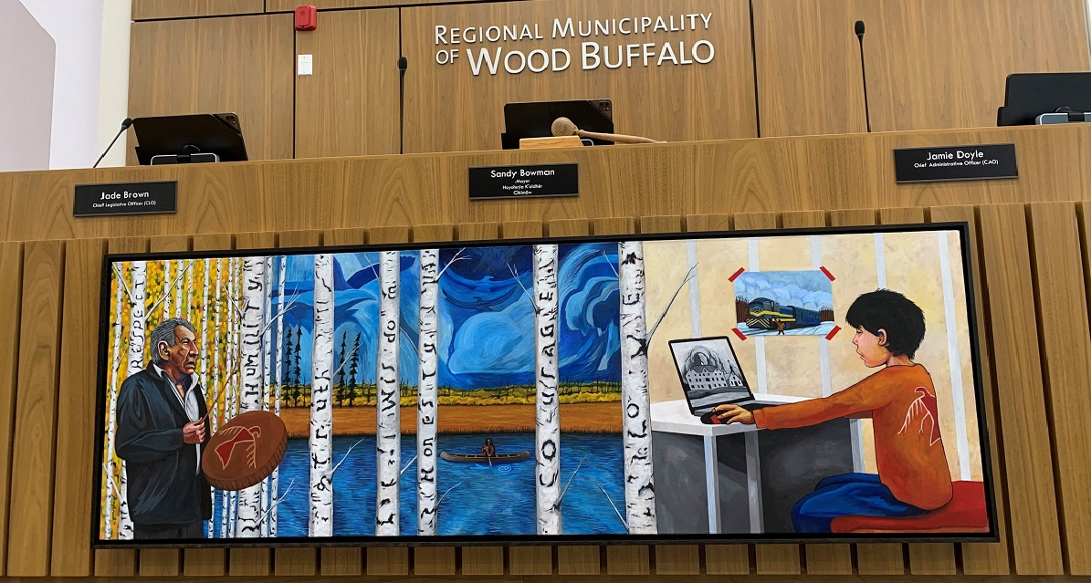
Council Chambers Tour & Indigenous Art
Have you been in Council Chambers since it was renovated?
Have you seen the Indigenous Art in Council Chambers?
Council Chambers will be opened for those wishing to visit the new Chambers and the Indigenous artwork.
Notes:
EDS is familiar with our region and have already done work for the OHV Master Plan Update, and Abasand OHV Staging Area. They are working on Draper Trail and Outdoor Equipment.

Slide 16
Participate Wood Buffalo: rmwb.ca/participate

Slide 17
Participate Wood Buffalo

Slide 18
Engagement Feedback Survey
Share your feedback on the Draper Engagement Series
April – October 2022 (so far...)
What kind of topics would you like to discuss at future meetings?
Are you satisfied with the current meeting locations or meeting formats?
Have found these meetings to be helpful and informative?
The survey will be open until November 14, 2022.
Complete the survey today or visit: rmwb.ca/participate >> Draper page.
Notes:
With colder temperatures approaching, as of Oct. 21 all new construction work to connect homes to municipal infrastructure is on hold until spring 2023. You may still start your RWSS application and continue making arrangements to connect your home. New contractor quotes should be submitted in the spring ahead of the 2023 construction season to ensure quotes are accurate and still valid. This change to the application process was made this year to help avoid construction and warranty issues that homeowners and contractors were encountering.
While construction is paused over the winter months, we want to help you move your RWSS application along. Connect with us through Pulse, and a project contact will follow up to answer your questions and assist with your application.
As always, for up-to-date information rmwb.ca/rwss

Slide 19
Upcoming Engagements
In the coming weeks, you can expect to be invited to share feedback on:
Trail Feasibility Study
Outdoor Exercise Equipment
Don't Forget:
Draper Engagement Feedback Survey
rmwb.ca/participate
Notes:
EDS is familiar with our region and have already done work for the OHV Master Plan Update, and Abasand OHV Staging Area. They are working on Draper Trail and Outdoor Equipment.

Slide 20
Next Sessions
We'll plan the next sessions based off what you tell us in the Engagement Feedback Survey.

Slide 21
Questions Thank you for joining us.

